Slide 1
Chapter 3
The Relational Model

Slide 2
Data and Its Structure
Data is actually stored as bits, but it is difficult to work with data at this level.
It is convenient to view data at different levels of abstraction.
Schema: Description of data at some abstraction level. Each level has its own schema.
We will be concerned with three schemas: physical, conceptual, and external.

Slide 3
Physical Data Level
Physical schema describes details of how data is stored: computer/disks, tracks, cylinders, indices etc.
Early applications worked at this level – explicitly dealt with details.
Problem: Routines were hard-coded to deal with physical representation.
Changes to data structure difficult to make.
Application code becomes complex since it must deal with details.
Rapid implementation of new features impossible.

Slide 4
Conceptual Data Level
Hides details.
In the relational model, the conceptual schema presents data as a set of tables.
DBMS maps from conceptual to physical schema automatically.
Physical schema can be changed without changing application:
DBMS would change mapping from conceptual to physical transparently
This property is referred to as physical data independence

Slide 5
Conceptual Data Level (con’t)
Conceptual view of data
Application
Physical view of data
DBMS

Slide 6
External Data Level
In the relational model, the external schema also presents data as a set of relations.
An external schema specifies a view of the data in terms of the conceptual level. It is tailored to the needs of a particular category of users.
Portions of stored data should not be seen by some users.
Students should not see their files in full.
Faculty should not see billing data.
Information that can be derived from stored data might be viewed as if it were stored.
GPA not stored, but calculated when needed.

Slide 7
External Data Level (con’t)
Application is written in terms of an external schema.
A view ( a virtual table) is computed when accessed (not stored).
Different external schemas can be provided to different user groups.
Translation from external to conceptual done automatically by DBMS at run time.
Conceptual schema can be changed without changing application:
Mapping from external to conceptual must be changed.
Referred to as conceptual data independence.

Slide 8
Levels of Abstraction
payroll
billing
records
View 1
View 2
View 3
External
schemas
Conceptual schema
Physical schema

Slide 9
Data Model
Schema: description of data at some level (e.g., tables, attributes, constraints, domains)
Model: tools and language for describing:
Conceptual and external schema
Data definition language (DDL)
Integrity constraints, domains (DDL)
Operations on data
Data manipulation language (DML)
Directives that influence the physical schema (affects performance, not semantics)
Storage definition language (SDL)

Slide 10
Relational Model
A particular way of structuring data (using relations)
Simple
Mathematically based
Expressions (≡ queries) can be analyzed by DBMS
Queries are transformed to equivalent expressions automatically (query optimization)
Optimizers have limits (=> programmer needs to know how queries are evaluated and optimized)

Slide 11
Relation Instance
Relation is a set of tuples
Tuple ordering immaterial
No duplicates
Cardinality of relation = number of tuples
All tuples in a relation have the same structure; constructed from the same set of attributes
Attributes are named (ordering is immaterial)
Value of an attribute is drawn from the attribute’s domain
There is also a special value null (value unknown or undefined), which belongs to no domain
Arity of relation = number of attributes

Slide 12
Relation Instance (Example)
Id Name Address Status
Student

Slide 13
Relation Schema
Relation name
Attribute names & domains
Integrity constraints like
The values of a particular attribute in all tuples are unique
The values of a particular attribute in all tuples are greater than 0
Default values

Slide 14
Relational Database
Finite set of relations
Each relation consists of a schema and an instance
Database schema = set of relation schemas constraints among relations (inter-relational constraints)
Database instance = set of (corresponding) relation instances

Slide 15
Database Schema (Example)
Student (Id: INT, Name: STRING, Address: STRING,
Status: STRING)
Professor (Id: INT, Name: STRING, DeptId: DEPTS)
Course (DeptId: DEPTS, CrsName: STRING,
CrsCode: COURSES)
Transcript (CrsCode: COURSES, StudId: INT,
Grade: GRADES, Semester: SEMESTERS)
Department(DeptId: DEPTS, Name: STRING)

Slide 16
Integrity Constraints
Part of schema
Restriction on state (or of sequence of states) of a database
Enforced by DBMS
Intra-relational - involve only one relation
Part of relation schema
e.g., all Ids are unique
Inter-relational - involve several relations
Part of relation schema or database schema

Slide 17
Constraint Checking
Automatically checked by DBMS
Protects database from errors
Enforces enterprise rules

Slide 18
Kinds of Integrity Constraints
Static – restricts legal states of database
Syntactic (structural)
e.g., all values in a column must be unique
Semantic (involve meaning of attributes)
e.g., cannot register for more than 18 credits
Dynamic – limitation on sequences of database states
e.g., cannot raise salary by more than 5%

Slide 19
Key Constraint
A key constraint is a sequence of attributes A₁,…,A_{n} (n=1 possible) of a relation schema, S, with the following property:
A relation instance s of S satisfies the key constraint iff at most one row in s can contain a particular set of values, a₁,…,a_{n}, for the attributes A₁,…,A_{n}
Minimality: no subset of A₁,…,A_{n} is a key constraint
Key
Set of attributes mentioned in a key constraint
e.g., Id in Student,
e.g., (StudId, CrsCode, Semester) in Transcript
It is minimal: no subset of a key is a key
(Id, Name) is not a key of Student

Slide 20
Why is （StudentId, CrsCode, Semester） a key?
StudentID | CrsCode | Semester | Grade
1111 | CSC4710 | Fall 2011 | D
2222 | CSC4710 | Fall 2011 | C
3333 | CSC4710 | Winter 2012 | B
1111 | CSC4710 | Winter 2012 | A
2222 | CSC4110 | Fall 2011 | B
3333 | CSC4991 | Winter 2012 | C

Slide 21
Superkey
Superkey (key container) - set of attributes containing key
(Id, Name) is a superkey of Student
Every relation has a key
Relation can have several keys:
primary key: Id in Student (can’t be null)
candidate key: (Name, Address) in Student

Slide 22
Key and Superkey
Is a Superkey a key?
Is a key a superkey?
Does a superkey contain a key?
Does a relation contain a key necesarrily?

Slide 23
Foreign Key Constraint
Referential integrity: Item named in one relation must refer to tuples that describe that item in another
Transcript (CrsCode) references Course(CrsCode )
Professor(DeptId) references Department(DeptId)
Attribute A₁ is a foreign key of R1 referring to attribute A₂ in R2, if
1) whenever there is a value v of A₁, there is a tuple of R2 in which A₂ has value v, and
2) A₂ is a key of R2

Slide 24
Foreign Key Constraint (Example)
FacId
f3
f1
f6
f2
f7
f4
Advisor
f6
f2
f3
f4
null
f3
Students
Faculty
Foreign key
(or key reference)
Candidate key

Slide 25
Questions
Is a foreign key a key?
Is a key a foreign key?
Can a key and a foreign key in the same table? (see next slide)

Slide 26
Foreign Key (cont’d)
Names of the attrs A₁ and A₂ need not be the same.
With tables:
ProfId attribute of Teaching references Id attribute of Professor
R1 and R2 need not be distinct.
Employee(Id:INT, MgrId:INT, ….)
Employee(MgrId) references Employee(Id)
Every manager is also an employee and hence has a unique row in Employee
Teaching(CrsCode: COURSES, Sem: SEMESTERS, ProfId: INT)
Professor(Id: INT, Name: STRING, DeptId: DEPTS)

Slide 27
Foreign Key Example
Id | MgrId | EmpName | Salary | StartDate
1111 | 3333 | Kathy | 50K | 2012
2222 | 3333 | John | 60K | 2011
3333 | 0000 | Cook | 100K | 2000
4444 | 0000 | Mathew | 75K | 2012
5555 | 1111 | Jun | 40K | 1015
Primary Key（ID),
FOREIGN KEY（MgrId) References Employee(Id)

Slide 28
Inclusion Dependency
Referential integrity constraint that is not a foreign key constraint
Teaching(CrsCode, Semester) references Transcript(CrsCode, Semester)
(no empty classes allowed)
Target attributes do not form a candidate key in Transcript (StudId missing)
No simple enforcement mechanism for inclusion dependencies in SQL (requires assertions -- later)

Slide 29
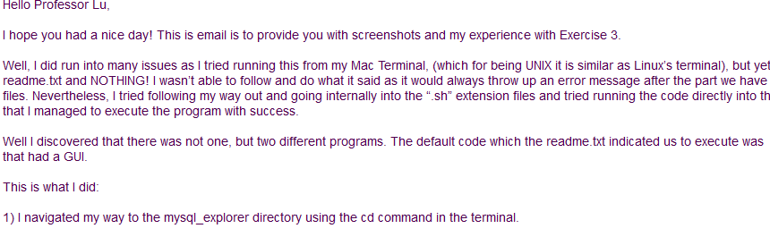
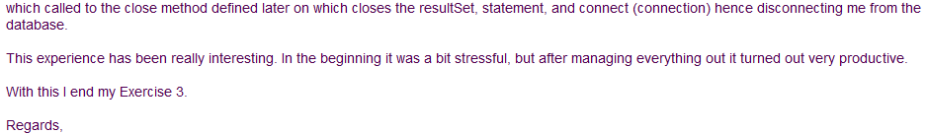
A Sample Exercise email
Courtesy of Karan Kishinani

Slide 30
SQL
Language for describing database schema and operations on tables
Data Definition Language (DDL): sublanguage of SQL for describing schema

Slide 31
Tables
SQL entity that corresponds to a relation
An element of the database schema
SQL-92 is currently the most supported standard but is now superseded by SQL:1999 and SQL:2003
Database vendors generally deviate from the standard, but eventually converge

Slide 32
Table Declaration
CREATE TABLE Student (
Id INTEGER,
Name VARCHAR(20),
Address VARCHAR(50),
Status VARCHAR(10)
);
INSERT INTO Student
VALUES (10122233, 'John', '10 Cedar St', 'Freshman');
INSERT INTO Student
VALUES (234567890, ‘Mary', ’22 Main St', ‘Sophmore');

Slide 33
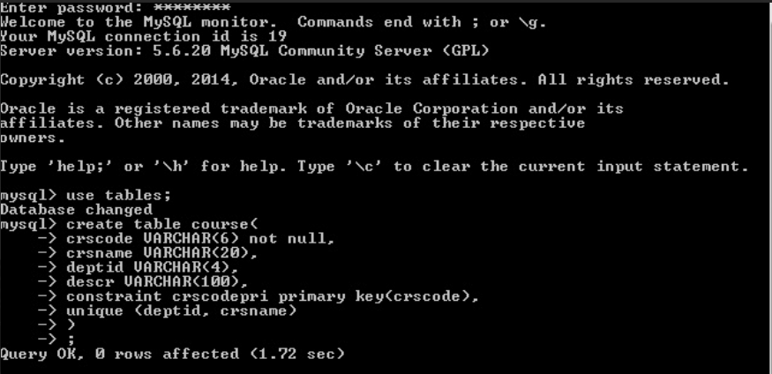
MySQL Screenshot
Credit of Hussein Siblini.

Slide 34
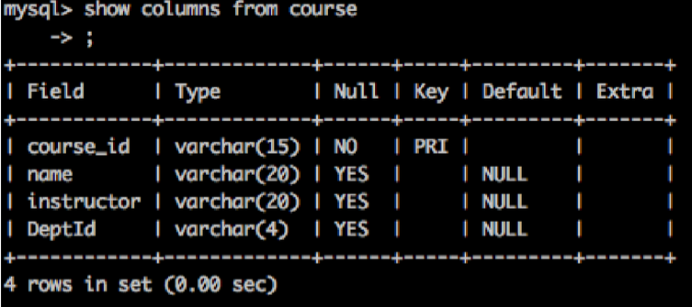
MySQL Screenshot
Credit of Zhipeng Liang

Slide 35
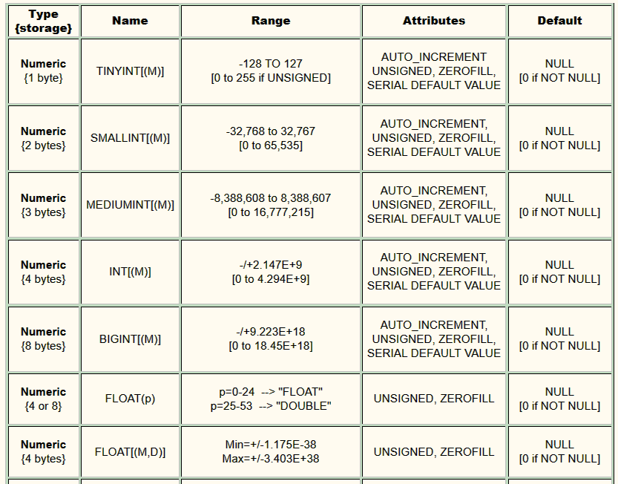
MySQL Datatypes

Slide 36
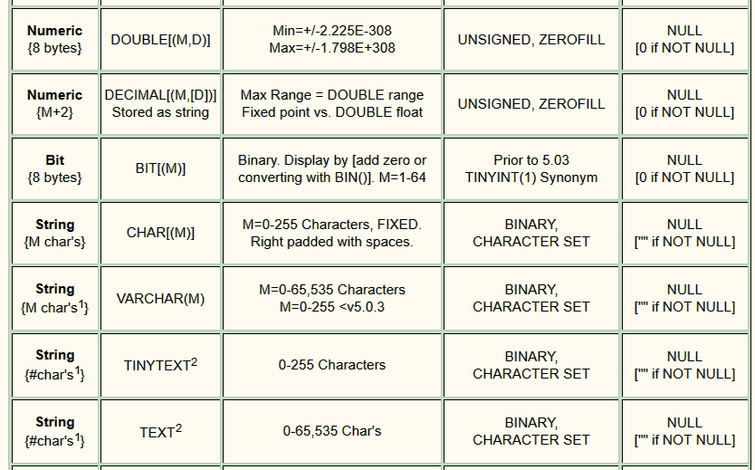
MySQL Datatypes (con’t)

Slide 37
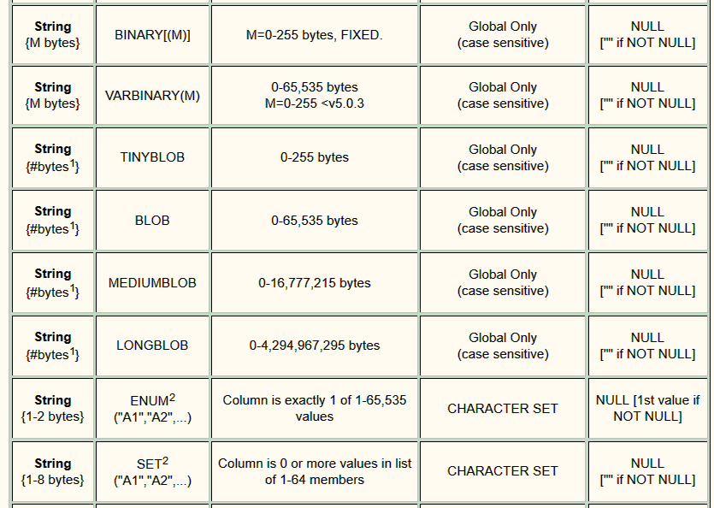
MySQL Datatypes (con’t)

Slide 38

MySQL Datatypes (con’t)

Slide 39
Primary/Candidate Keys
CREATE TABLE Course (
CrsCode CHAR(6),
CrsName CHAR(20),
DeptId CHAR(4),
Descr CHAR(100),
PRIMARY KEY (CrsCode),
UNIQUE (DeptId, CrsName) -- candidate key
)
Comments start with 2 dashes

Slide 40
Null
Problem: Not all information might be known when row is inserted (e.g., Grade might be missing from Transcript)
A column might not be applicable for a particular row (e.g., MaidenName if row describes a male)
Solution: Use place holder – null
Not a value of any domain (although called null value)
Indicates the absence of a value
Not allowed in certain situations
Primary keys and columns constrained by NOT NULL

Slide 41
Default Value
Value to be assigned if attribute value in a row
is not specified
CREATE TABLE Student (
Id INTEGER,
Name CHAR(20) NOT NULL,
Address CHAR(50),
Status CHAR(10) DEFAULT ‘freshman’,
PRIMARY KEY (Id) )

Slide 42
Semantic Constraints in SQL
Primary key and foreign key are examples of structural constraints
Semantic constraints
Express the logic of the application at hand:
e.g., number of registered students ≤ maximum enrollment

Slide 43
Semantic Constraints (cont’d)
Used for application dependent conditions
Example: limit attribute values
Each row in table must satisfy condition
CREATE TABLE Transcript (
StudId INTEGER,
CrsCode CHAR(6),
Semester CHAR(6),
Grade CHAR(1),
CHECK (Grade IN (‘A’, ‘B’, ‘C’, ‘D’, ‘F’)),
CHECK (StudId > 0 AND StudId < 1000000000) )

Slide 44
Question
How to support “A+”, “A-”, “B+”, “B-”?

Slide 45
Semantic Constraints (cont’d)
Example: relate values of attributes in different columns
CREATE TABLE Employee (
Id INTEGER,
Name CHAR(20),
Salary INTEGER,
MngrSalary INTEGER,
CHECK ( MngrSalary > Salary) )

Slide 46
Constraints – Problems
Problem 1: Empty table always satisfies all CHECK constraints (an idiosyncrasy of the SQL standard)
If Employee is empty, there are no rows on which to evaluate the CHECK condition.
CREATE TABLE Employee (
Id INTEGER,
Name CHAR(20),
Salary INTEGER,
MngrSalary INTEGER,
CHECK ( 0 < (SELECT COUNT (*) FROM Employee)) )

Slide 47
Constraints – Problems
Problem 2: Inter-relational constraints should be symmetric
Why should constraint be in Employee an not Manager?
What if Employee is empty?
CREATE TABLE Employee (
Id INTEGER,
Name CHAR(20),
Salary INTEGER,
MngrSalary INTEGER,
CHECK ((SELECT COUNT (*) FROM Manager) <
(SELECT COUNT (*) FROM Employee)) )

Slide 48
Assertion
Element of schema (like table)
Symmetrically specifies an inter-relational constraint
Applies to entire database (not just the individual rows of a single table)
hence it works even if Employee is empty
CREATE ASSERTION DontFireEveryone
CHECK (0 < SELECT COUNT (*) FROM Employee)

Slide 49
Assertion
CREATE ASSERTION KeepEmployeeSalariesDown
CHECK (NOT EXISTS(
SELECT * FROM Employee E
WHERE E.Salary > E.MngrSalary))
EXISTS(R) is a boolean function (called predicate)
Returns true when R it not empty
Return false otherwise
NOT EXISTS(R) ≡ isEmpty(R) ≡ (R = Φ)

Slide 50
Assertions and Inclusion Dependency
CREATE ASSERTION NoEmptyCourses
CHECK (NOT EXISTS (
SELECT * FROM Teaching T
WHERE T.roster() = Φ)
)
Courses with no students
Students in a particular course
Idea: search those courses in Teaching such that they have no registered students.
But how to write T.roster() = Φ in SQL?

Slide 51
Assertions and Inclusion Dependency
CREATE ASSERTION NoEmptyCourses
CHECK (NOT EXISTS (
SELECT * FROM Teaching T
WHERE -- for each row T check
-- the following condition
NOT EXISTS (
SELECT * FROM Transcript R
WHERE R.CrsCode = T.CrsCode
AND R.Semester = T.Semester )
) )
Courses with no students
Idea: search those courses in Teaching such that they have no registered students.
Students in a particular course

Slide 52
Domains
Possible attribute values can be specified
Using a CHECK constraint or
Creating a new domain
Domain can be used in several declarations
Domain is a schema element
CREATE DOMAIN Grades CHAR (1)
CHECK (VALUE IN (‘A’, ‘B’, ‘C’, ‘D’, ‘F’))
CREATE TABLE Transcript (
….,
Grade: Grades,
… )

Slide 53
Foreign Key Constraint
CREATE TABLE Teaching (
ProfId INTEGER,
CrsCode CHAR (6),
Semester CHAR (6),
PRIMARY KEY (CrsCode, Semester),
FOREIGN KEY (CrsCode) REFERENCES Course,
FOREIGN KEY (ProfId) REFERENCES Professor (Id) )

Slide 54
Foreign Key Constraint
CrsCode
CrsCode
ProfId
x
x
y
Course
Id
Teaching
y
Professor

Slide 55
Circularity in Foreign Key Constraint
A₁
A₂
A₃
B₁
B₂
B₃
A
y
x
x
y
B
candidate key: A₁
foreign key: A₃ references B(B₁)
candidate key: B₁
foreign key: B₃ references A(A₁)
Problem 1: Creation of A requires existence of B and vice versa
Solution: CREATE TABLE A ( ……) -- no foreign key
CREATE TABLE B ( ……) -- include foreign key
ALTER TABLE A
ADD CONSTRAINT cons
FOREIGN KEY (A₃) REFERENCES B (B₁)

Slide 56
Circularity in Foreign Key Constraint (cont’d)
Problem 2: Insertion of row in A requires prior existence of row in B and vice versa
Solution: use appropriate constraint checking mode:
IMMEDIATE checking
DEFERRED checking

Slide 57
Reactive Constraints
Constraints enable DBMS to recognize a bad state and reject the statement or transaction that creates it
More generally, it would be nice to have a mechanism that allows a user to specify how to react to a violation of a constraint
SQL-92 provides a limited form of such a reactive mechanism for foreign key violations

Slide 58
Handling Foreign Key Violations
Insertion into A: Reject if no row exists in B containing foreign key of inserted row
Deletion from B:
NO ACTION: Reject if row(s) in A references row to be deleted (default response)
A
x
B
x
?
Request to delete row rejected

Slide 59
Handling Foreign Key Violations (cont’d)
Deletion from B (cont’d):
SET NULL: Set value of foreign key in referencing row(s) in A to null
Change to NULL
B
A
X
x
Row deleted

Slide 60
Handling Foreign Key Violations (cont’d)
Deletion from B (cont’d):
SET DEFAULT: Set value of foreign key in referencing row(s) in A to default value (y) which must exist in B
Change to y
y
A
B
x
x
Row deleted

Slide 61
Handling Foreign Key Violations (cont’d)
Deletion from B (cont’d):
CASCADE: Delete referencing row(s) in A as well
A
B
x
x
x
Row deleted
Rows deleted too

Slide 62
Handling Foreign Key Violations (cont’d)
Update (change) foreign key in A: Reject if no row exists in B containing new foreign key
Update candidate key in B (to z) – same actions as with deletion:
NO ACTION: Reject if row(s) in A references row to be updated (default response)
SET NULL: Set value of foreign key to null
SET DEFAULT: Set value of foreign key to default
CASCADE: Propagate z to foreign key
Cascading when key in B changed from x to z
A
z
B
z

Slide 63
Handling Foreign Key Violations (cont’d)
The action taken to repair the violation of a foreign key constraint in A may cause a violation of a foreign key constraint in C
The action specified in C controls how that violation is handled;
If the entire chain of violations cannot be resolved, the initial deletion from B is rejected.
y
y
x
x
C
A
B

Slide 64
Specifying Actions
CREATE TABLE Teaching (
ProfId INTEGER,
CrsCode CHAR (6),
Semester CHAR (6),
PRIMARY KEY (CrsCode, Semester),
FOREIGN KEY (ProfId) REFERENCES Professor (Id)
ON DELETE NO ACTION
ON UPDATE CASCADE,
FOREIGN KEY (CrsCode) REFERENCES Course (CrsCode)
ON DELETE SET NULL
ON UPDATE CASCADE )

Slide 65
Triggers
A more general mechanism for handling events
Not in SQL-92, but is in SQL:1999
Trigger is a schema element (like table, assertion, …)
CREATE TRIGGER CrsChange
AFTER UPDATE OF CrsCode, Semester ON Transcript
WHEN (Grade IS NOT NULL)
ROLLBACK

Slide 66
An example
CREATE TRIGGER grade_check BEFORE INSERT ON student
FOR EACH ROW
BEGIN
IF new.grade not in ( 'A', 'B', 'C' ) THEN
SIGNAL SQLSTATE '12345'
SET MESSAGE_TEXT = 'Grade should be any of (A, B, C)';
END IF;
END

Slide 67
Views
Schema element
Part of external schema
A virtual table constructed from actual tables on the fly
Can be accessed in queries like any other table
Not materialized, constructed when accessed
Similar to a subroutine in ordinary programming

Slide 68
Views - Examples
Part of external schema suitable for use in Bursar’s office:
CREATE VIEW CoursesTaken (StudId, CrsCode, Semester) AS
SELECT T.StudId, T.CrsCode, T.Semester
FROM Transcript T
Part of external schema suitable for student with Id 123456789:
CREATE VIEW CoursesITook (CrsCode, Semester, Grade) AS
SELECT T.CrsCode, T.Semester, T.Grade
FROM Transcript T
WHERE T.StudId = ‘123456789’

Slide 69
Modifying the Schema
ALTER TABLE Student
ADD COLUMN Gpa INTEGER DEFAULT 0
ALTER TABLE Student
ADD CONSTRAINT GpaRange
CHECK (Gpa >= 0 AND Gpa <= 4)
ALTER TABLE Transcript
DROP CONSTRAINT Cons -- constraint names are useful
DROP TABLE Employee
DROP ASSERTION DontFireEveryone

Slide 70
Access Control
Databases might contain sensitive information
Access has to be limited:
Users have to be identified – authentication
Generally done with passwords
Each user must be limited to modes of access appropriate to that user - authorization
SQL:92 provides tools for specifying an authorization policy but does not support authentication (vendor specific)

Slide 71
Controlling Authorization in SQL
GRANT access_list
ON table
TO user_list
access modes: SELECT, INSERT, DELETE, UPDATE, REFERENCES
GRANT UPDATE (Grade) ON Transcript TO prof_smith
– Only the Grade column can be updated by prof_smith
GRANT SELECT ON Transcript TO joe
– Individual columns cannot be specified for SELECT access (in the
SQL standard) – all columns of Transcript can be read
– But SELECT access control to individual columns can be simulated
through views (next)
User name

Slide 72
Controlling Authorization in SQL Using Views
GRANT access
ON view
TO user_list
GRANT SELECT ON CoursesTaken TO joe
– Thus views can be used to simulate access control to individual columns of a table

Slide 73
Authorization Mode REFERENCES
Foreign key constraint enforces relationship between tables that can be exploited to
Control access: can enable perpetrator prevent deletion of rows
Reveal information: successful insertion into DontDissmissMe means a row with foreign key value exists in Student
CREATE TABLE DontDismissMe (
Id INTEGER,
FOREIGN KEY (Id) REFERENCES Student
ON DELETE NO ACTION )
INSERT INTO DontDismissMe (‘111111111’)

Slide 74
REFERENCE Access mode (cont’d)
GRANT REFERENCES
ON Student
TO joe

Slide 75
Exercise 4
Check out Blackboard announcement and Content for exercise 4.
You will need to download and install Tomcat 7 and Eclipse Kepler version to support exercise 4.
Read the readme.txt and the youtube for details.

Slide 76
JDBC – Java package for SQL

Slide 77
Include JDBC jar file
Add JDBC jar library manually to the project: Right click the project -> build path -> configure build path
In libraries Tab press Add Eternal Jar and Select your Jar.

Slide 78
Connect to Mysql Database Server
Run the MySQL service (in Windows, run services.msc)
Class.forName("com.mysql.jdbc.Driver");
connect = DriverManager .getConnection("jdbc:mysql://141.217.48.128:3306/dataview?” + "user=shiyong&password=view1234");

